Slide 1
IBM HR DATA ANALYTICS
Team 2-16
Aliyah Wooten, Megan Ling
Haolin Hong, Zoe Bai

Slide 2

Data overview
In total, this dataset contains 1470 records and 35 variables
19 numeric variables and 16 categorical variables
Human Resource Data
Demographic data
Job related data
Target variable: Attrition (Yes or No)
No NULL value
Fictional data

Slide 3

Business goal
Binary classification case
Predict if an employee will quit his/her job
Uncover what factors lead to employee attrition
Explore important questions
Is there a relationship between the education level and attrition?
…

Slide 4
Analysis Plan
Data Preprocessing
Supervised Learning
AdaBoost
Random Forest
SVM
EDA
Unsupervised Learning
PCA

Slide 5
Data preprocessing
Delete 3 columns with same value, such as “Over 18”
Split training and test set (7:3)
Convert to dummy variables (SVM-PCA)

Slide 6
Exploratory data analysis
Imbalanced classification
Raise potential problems
Recall how bootstrap works
21 : 4

Slide 7
Exploratory data analysis
Gender VS Attrition
Marital Status VS Attrition
88%
85%
74%
90%
17%
15%
10%
12%
26%

Slide 8
Exploratory data analysis
Travel VS Attrition
Education VS Attrition
85%
75%
82%
91%
25%
15%
18%

Slide 9
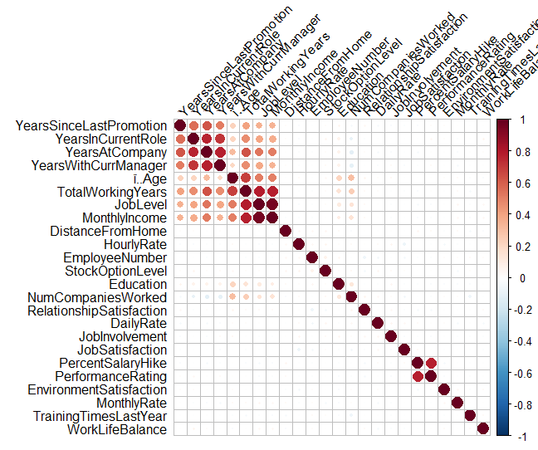
Exploratory data analysis
From this correlation matrix we can see, some variables are correlated with others.
The performance of some algorithms can deteriorate if two or more variables are tightly related, called multicollinearity.

Slide 10
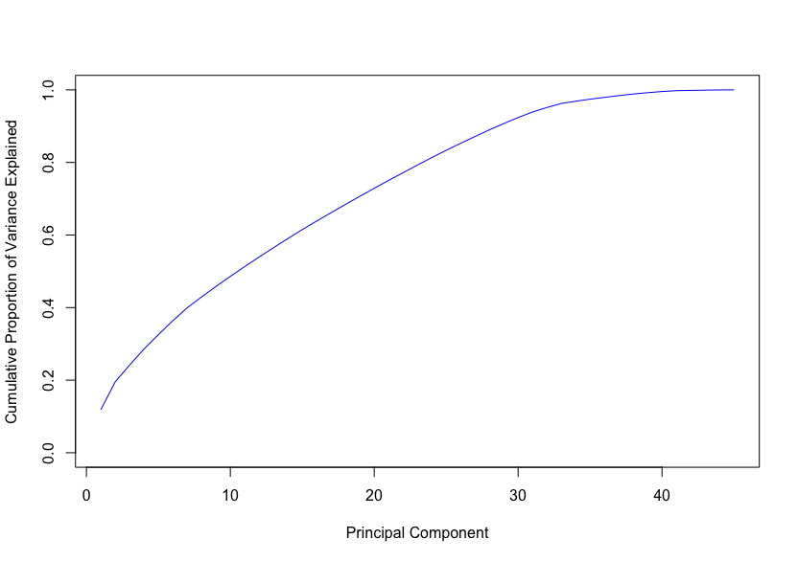
Unsupervised learning: PCA
% of Variance: 95
# of components: 32
Reduce Dimensions
Remedy multicollinearity
Reduce covariate dimensions
Maximize the amount of variation
% of Variance: 80
# of components: 24
% of Variance: 50
# of components: 11

Slide 11
Dealing with imbalance
Oversampling
Select more samples from minority group
(Yes: 50, No: 250) → (Yes:250, No:250)
Undersampling
Select less samples from majority group
(Yes:50, No:250) → (Yes:50, No:50)
ROSE sampling
Combination of over and under sampling
P: Probability of resampling from rare class (default 0.5)

Slide 12

Weighted accuracy
${err}^{+}= \frac{FN}{FN+TP}$
${err}^{−}=\frac{FP}{TN+FP}$
$1−[β{err}^{+}+\left(1−β\right){err}^{−}]$
 | No | Yes
No | TN | FP
Yes | FN | TP

Slide 13
Svm - pca
 |  | Recall | Precision | F1 Score | Accuracy | Weighted Accuracy
SVM | Linear | 0.461 | 0.729 | 0.565 | 0.878 | 0.561
 | Radical | 0 | 0 | 0 | 0.828 | 0.200
SVM – PCA50 | Linear | 0 | 0 | 0 | 0.828 | 0.200
 | Radical | 0.013 | 0.500 | 0.025 | 0.828 | 0.210
SVM – PCA80 | Linear | 0 | 0 | 0 | 0.828 | 0.200
 | Radical | 0 | 0 | 0 | 0.828 | 0.200
SVM – PCA95 | Linear | 0.474 | 0.900 | 0.621 | 0.900 | 0.577
 | Radical | 0 | 0 | 0 | 0.828 | 0.200
Linear performed better than radical.
Best model has 311 support vectors, with 441 total records in test set.

Slide 14
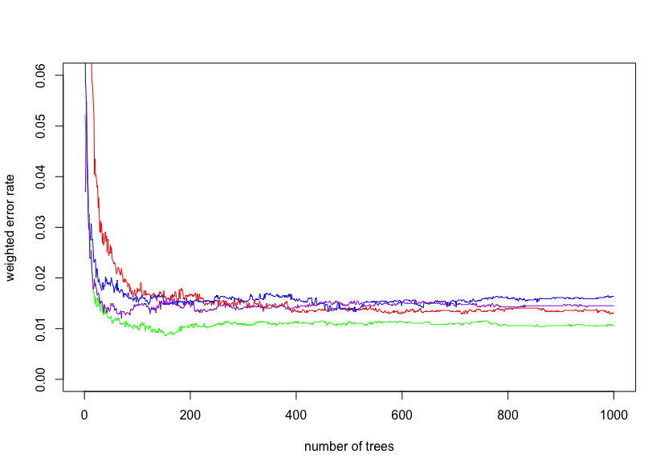
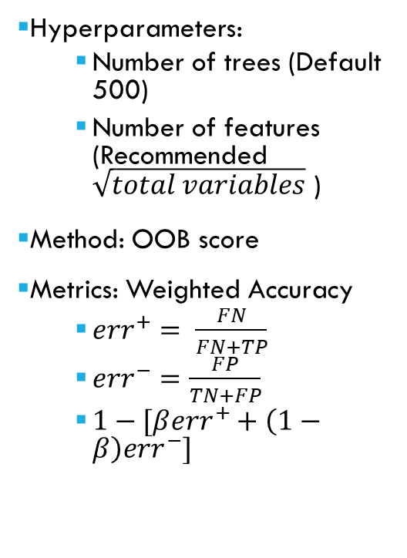
Random forest: Hyperparameter selection
Hyperparameters:
Number of trees (Default 500)
Number of features (Recommended $\sqrt{total variables}$ )
Method: OOB score
Metrics: Weighted Accuracy
${err}^{+}= \frac{FN}{FN+TP}$
${err}^{−}=\frac{FP}{TN+FP}$
$1−[β{err}^{+}+\left(1−β\right){err}^{−}]$
Lowest Point

Slide 15
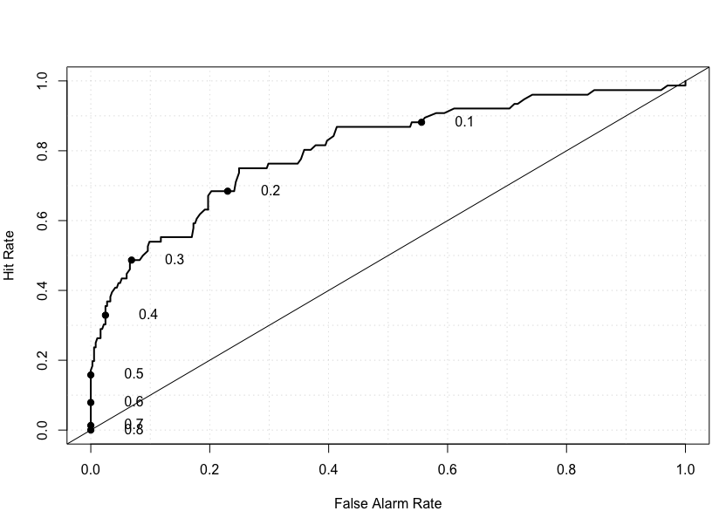
Random forest
 | Original | Ori – cutoff 0.2 | Ori – cutoff 0.1
Recall | 0.316 | 0.684 | 0.895
Precision | 0.296 | 0.380 | 0.249
F1 Score | 0.307 | 0.489 | 0.390
Accuracy | 0.753 | 0.753 | 0.517
Weighted Accuracy | 0.421 | 0.701 | 0.803

Slide 16
Random forest: comparation
 | Recall | Precision | F1 Score | Accuracy | Weighted Accuracy
Original | 0.316 | 0.296 | 0.307 | 0.753 | 0.421
Over Sampling | 0.263 | 0.741 | 0.388 | 0.857 | 0.407
Under Sampling | 0.684 | 0.333 | 0.448 | 0.710 | 0.690
ROSE Sampling | 0.434 | 0.500 | 0.465 | 0.828 | 0.529
Consider accuracy: Oversampling RandomForest wins!
Consider weighted accuracy: Under sampling RandomForest wins!
Consider both: ROSE sampling wins!

Slide 17
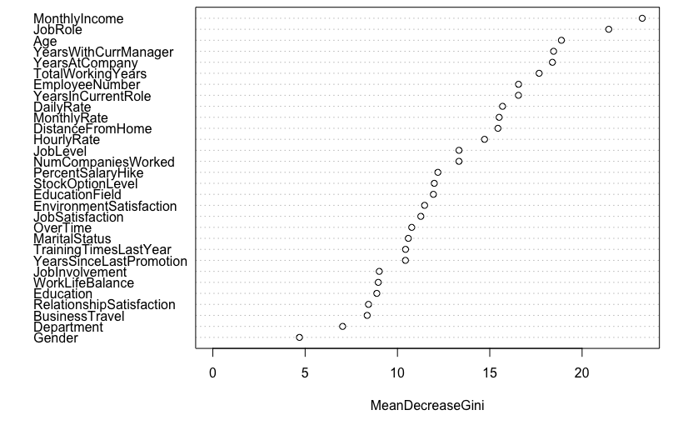
Random forest: feature importance

Slide 18
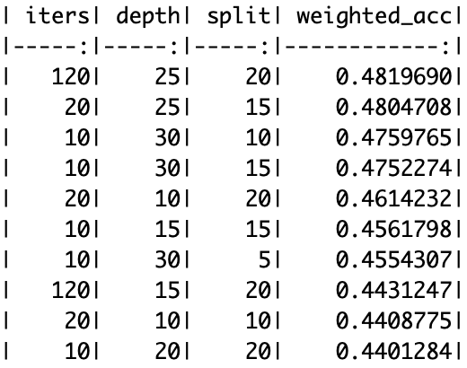
Adaboost: hyperparameter selection
Hyperparameter:
Number of iterations
Maximum depth of trees
Minimum split samples
Method: Validation Set
Metrics: Weighted Accuracy
Highest Score

Slide 19
adaboost: comparation
 | Recall | Precision | F1 Score | Accuracy | Weighted Accuracy
Adaboost | 0.355 | 0.871 | 0.504 | 0.880 | 0.482
Over Sampling | 0.355 | 0.711 | 0.474 | 0.864 | 0.478
Under Sampling | 0.618 | 0.280 | 0.385 | 0.660 | 0.628
ROSE Sampling | 0.513 | 0.527 | 0.520 | 0.837 | 0.591
Consider accuracy: Original Adaboost wins!
Consider weighted accuracy: Under sampling Adaboost wins!
Consider both: ROSE sampling wins!

Slide 20
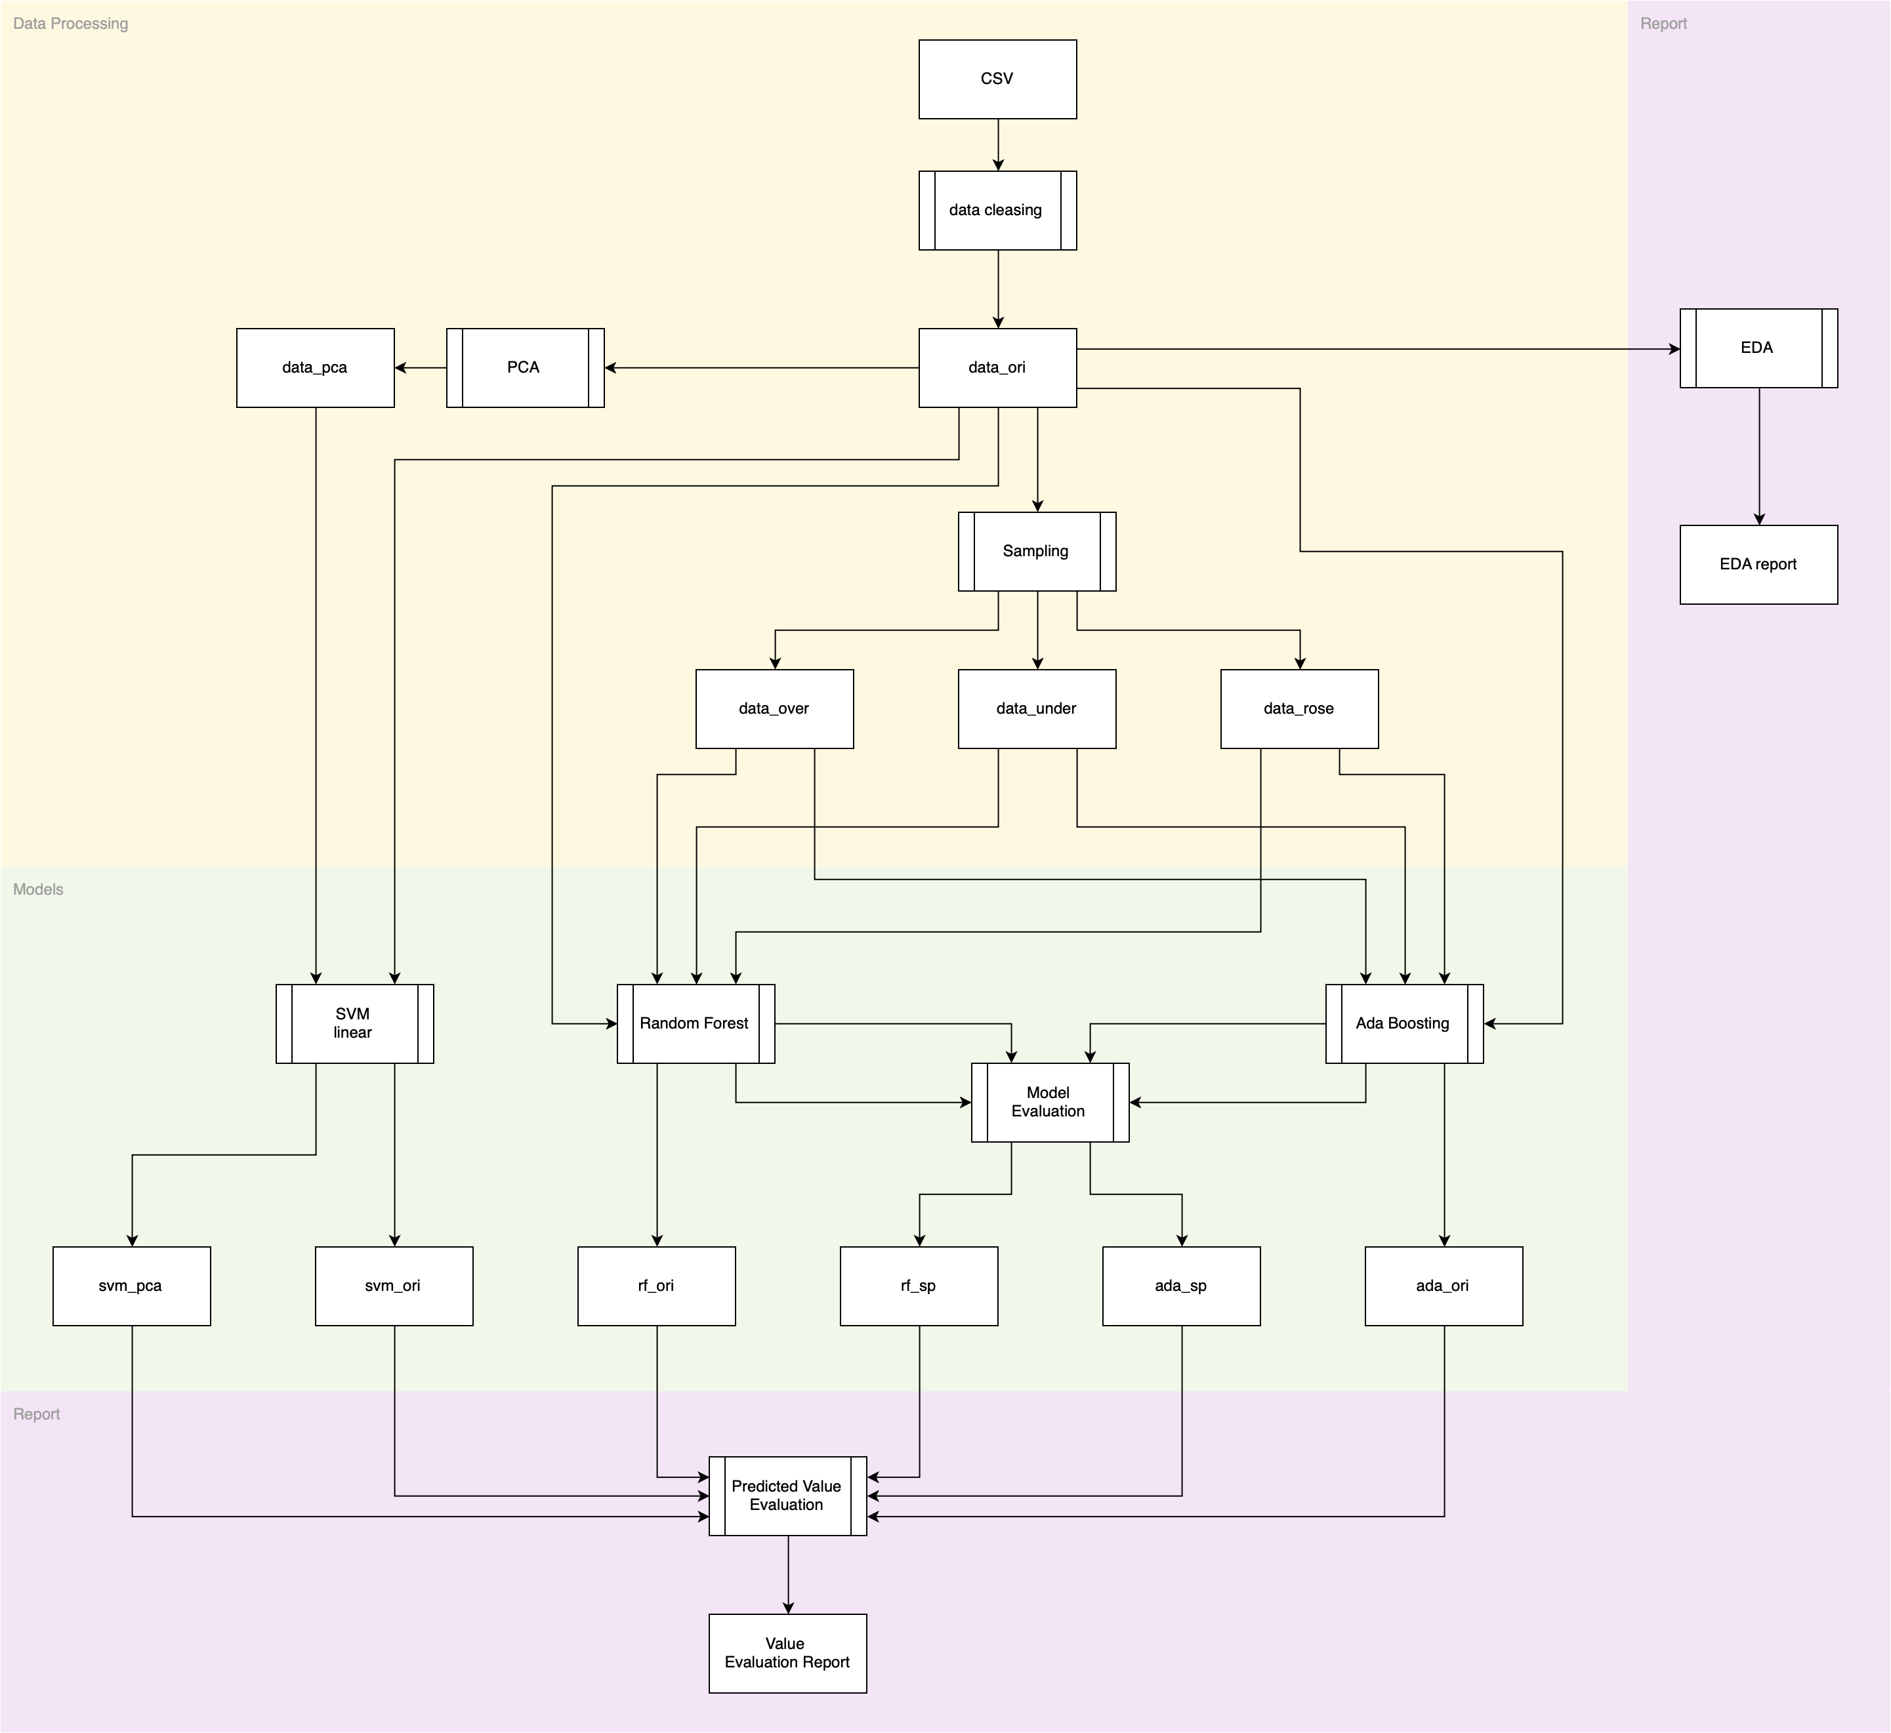
summary
Fewer principal components might lose information.
SVM (linear kernel) using 33 principal components which explain 95% of variance performed best in predicting if an employee will quit his job.
Random Forest features importance report uncovered factors that lead to employee attrition.
Income and job role play critical roles
Gender has little impact on employee attrition

Slide 21

Thanks for watching
Team 2-16

